Slide 1


Plane fight report

Slide 2
Introduction &problem statement
Our plane will fight with hostile planes. Our plane is on the bottom of the screen and hostile planes emerge from the top of the screen and slowly move towards our plane.
We can move our plane and fire to hostile planes. They can also fire to us.
There are two mode: survival mode and timekeeping mode
There is a background music
We can challenge the history highest score.

Slide 3
Analysis
To show the planes, we should use easyx function to draw the planes.
To control planes, we should use a function to check if there is input on the keyboard and convert the input to the change of corresponding parameters.
To check if the planes are hit, we should calculate the corresponding parameters by some formulas.
To update planes’ location, we should make a loop and draw planes in every circle.

Slide 4
Deisgn
Input?
Output:
planes
No
Start
Initialzie parameters
Yes
Change parameters according input
No
End
Chance=0?
Time =0?
Score=n?
Change parameters without input
Yes

Slide 5
Group division
First person
Control and show our plane and hostile planes. Use the pointers to save all the parameters. Check the parameters, link functions and control all the process.
Second person
Draw boot animation. Set background music. Write boss section, link functions of boss and control the boss process. Hide cursor.
Third person
Draw my and hostile planes. Fire bullets. Save scores. Draw win and lose animation. Control main function. Randomly show planes function.

Slide 6
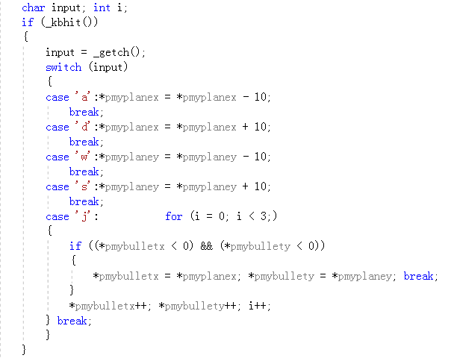
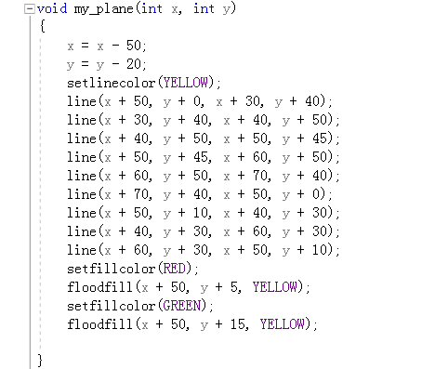
Implement
2、Check input
1、Use easyx function to draw planes

Slide 7
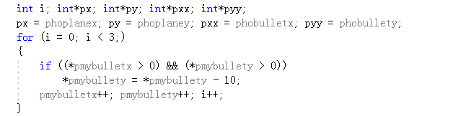
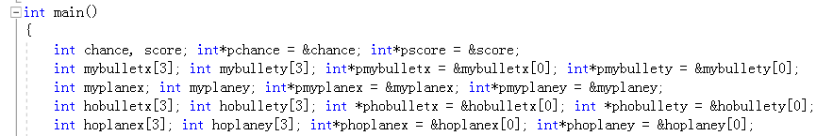
3、Make bullets move forward
4、Use pointer to store parameter

Slide 8
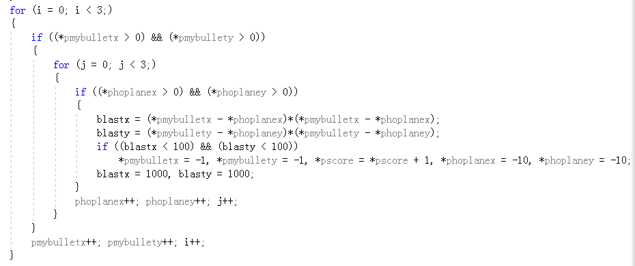
5、Check if the bullet hits the plane

Slide 9
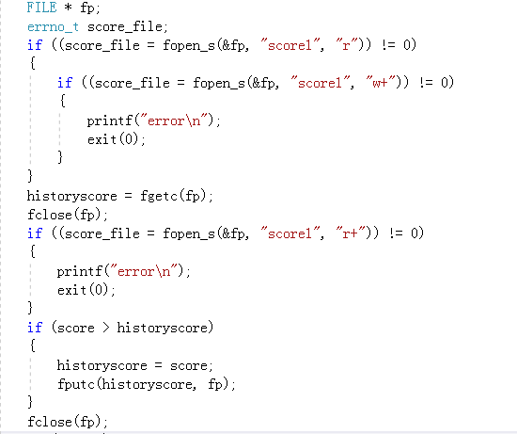
6、Save the history highest score

Slide 10
Testing
Input | Expect output | output | whether wrong
w | Plane move forward | Plane move forward | No
a | Plane move left | Plane move left | No
s | Plane move down | Plane move down | No
d | Plane move right | Plane move right | No
j | fire | fire | No
Invalid input
Enter or space | No effect | No effect | No
Character keys like f or g | No effect | No effect | No

Slide 11
Conclusion&evolution
We have done all the program.
The game is fluent.
There are also something to improve such as the boot animation can be redrew by easyx function. And we also need to prevent two planes appearing at the same place.

Slide 12
Thanks for your listening
06/04/17

